Slide 1
Bruin Swipes
Swipe exchange made easy
Notes:
Presenting: Everyone
Introduce yourself
replace buy or sell with exchange?
Introduce everyone here

Slide 2
What is it?
Way to connect potential buyers and sellers
Notes:
Presenting: Bobby
Swipes
Too many (19P)
Too few (11, apartment life)
We make it easy to connect them

Slide 3
Why?
There is no Goldilocks meal plan
Notes:
Presenting: Matthew
Elevator pitch
There is no one-size-fits-you meal plan. You decide on a plan at the beginning of the quarter and have hope that it works out just right.
Use cases
19 P — I had a roommate first year who had 19P. At the end of the quarter, he had over 50 swipes left over. Not knowing how to get rid of those swipes, he ended up buying 110 drinks from bcafe and stashing them under his bed. If he could have sold even a fraction of those swipes, it would have been a much better experience for him.
11 I have also had many friends with 11 plans who were never able to eat with friends on the weekend because they didn’t have any swipes left over.

Slide 4
Design
Google Backend
iOS
iOS
Android
Android
Notes:
Presenting: Kyle
We realized that the best way to do this would be through native mobile apps. Therefore we went with making apps for both iOS and Android.
We also needed a way to connect them to each other, to create the largest audience possible. For this reason we chose the Google Mobile Backend Starter Kit

Slide 5
Technologies

Slide 6
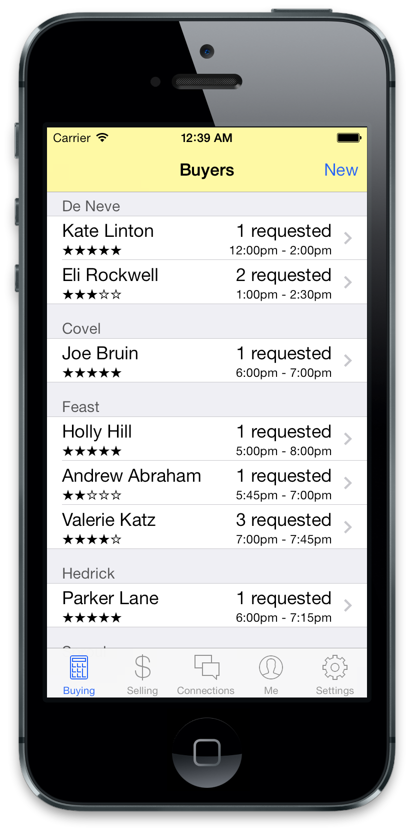
iOS Technologies
Xcode
iOS Simulator
Device testing
Notes:
Presenting: Matthew

Slide 7
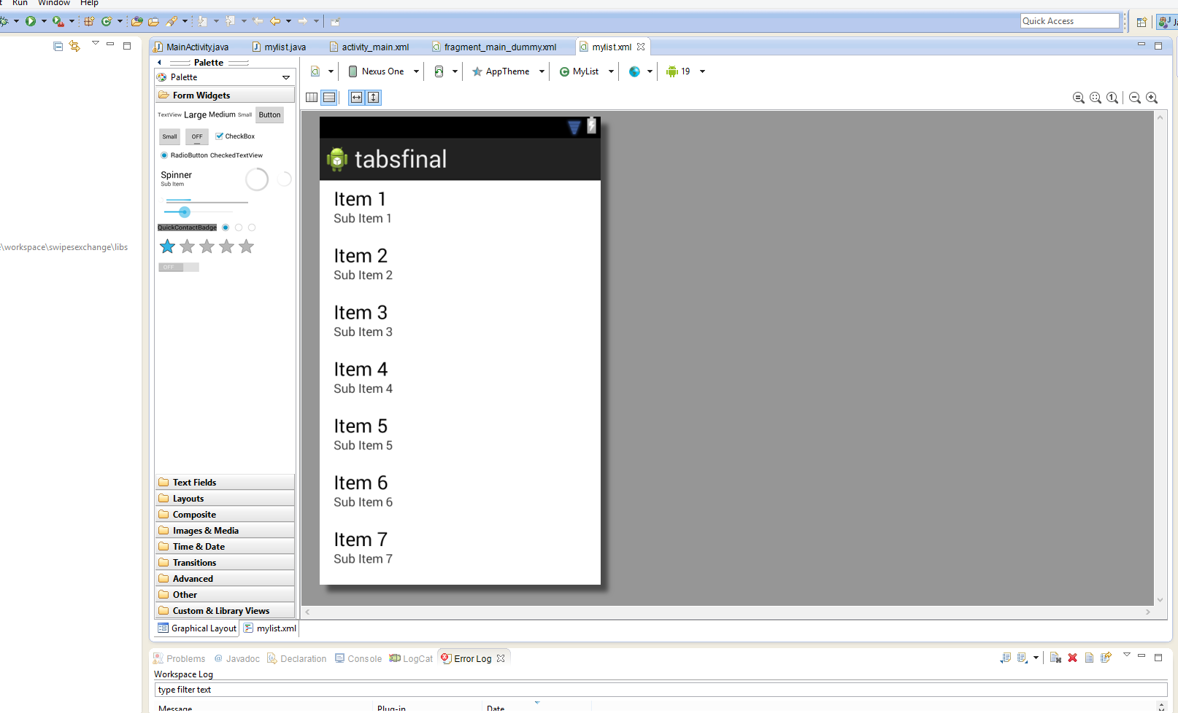
Android Technologies
-Eclipse IDE
-Android Development Tools (ADT) for Eclipse
-set-up, compile, and debug Android projects
-graphical XML Editor
-Android Virtual Devices
Notes:
Presenting: Kyle

Slide 8
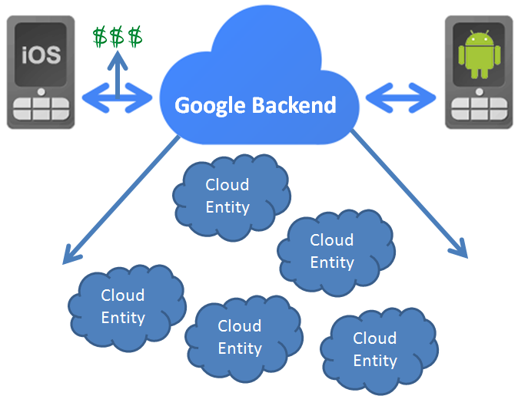
Backend — Data Storage
Notes:
Presenting: Rukan
iOS = Xcode
Android = Eclipse
Google Mobile Backend Starter

Slide 9
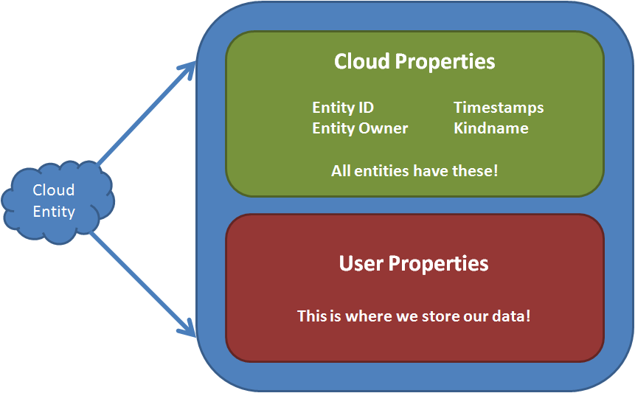
What is an Entity?
Notes:
Presenting: Rukan

Slide 10
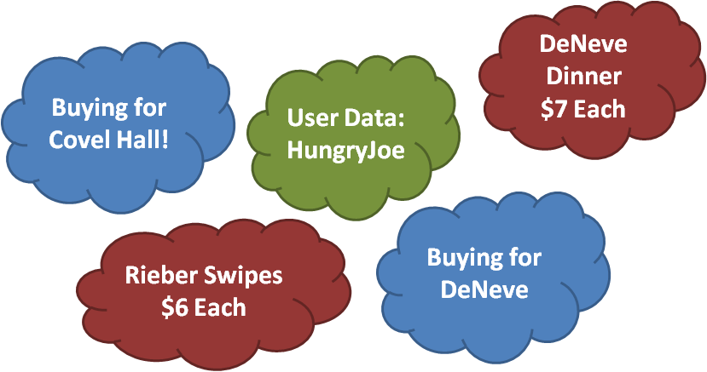
What Will Our Data Look Like?
Notes:
Presenting: Rukan
Each time a user creates a new account, or a new listing, we will generate a new cloud entity.
Aside from size limitations, why don’t we just store lots of data in single entities?
When you update a cloud entity, it overrides the previous entity, meaning the potential problem of race conditions.

Slide 11


Backend — Retrieving Data
- Multiple Backends?
- Set a Time Scope
- Limit Responses
- Sort Responses
I want
my data!
Notes:
Presenting: Rukan
Old slide text
- Query a Backend
We may have multiple backends, which
one are we using?
- Filter for Names
Lets say: we want all the cloud entities
with the name “Buyer List”
- Set a Time Scope
Do you just want past data?
Do you want notifications for new data?
Both?
- Set a Limit
It’s good practice to limit the number of
results that can be returned.
- Sort the Cloud Entities
Pick a property
Pick ascending or descending order
- Only Data We Want
Filters support logical operations
Ex - “I only want buyers for DeNeve
Dining Hall”
Data processing is handled almost completely server side. The user just needs to specify what data he or she wants.

Slide 12
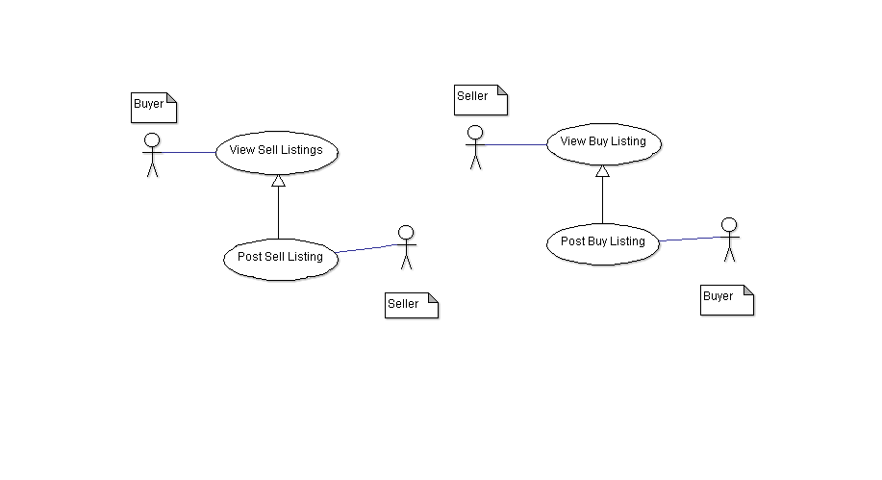
UML
Use Case - Buy and Sell Listings:
Notes:
Presenting: Bobby

Slide 13
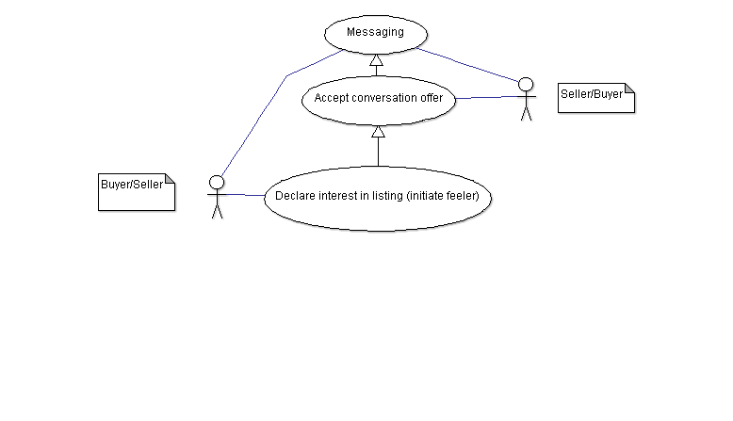
UML (cont.)
Use Case - Messaging:
Notes:
Presenting: Bobby

Slide 14
User Interface

Slide 15
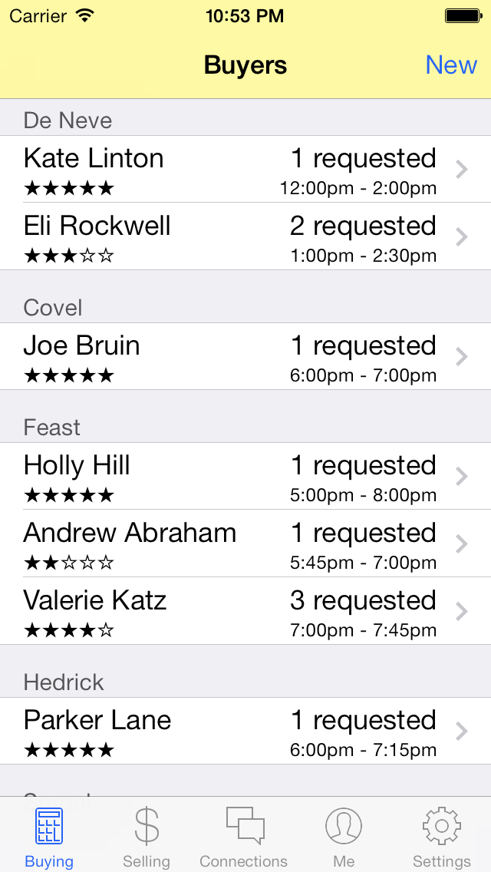
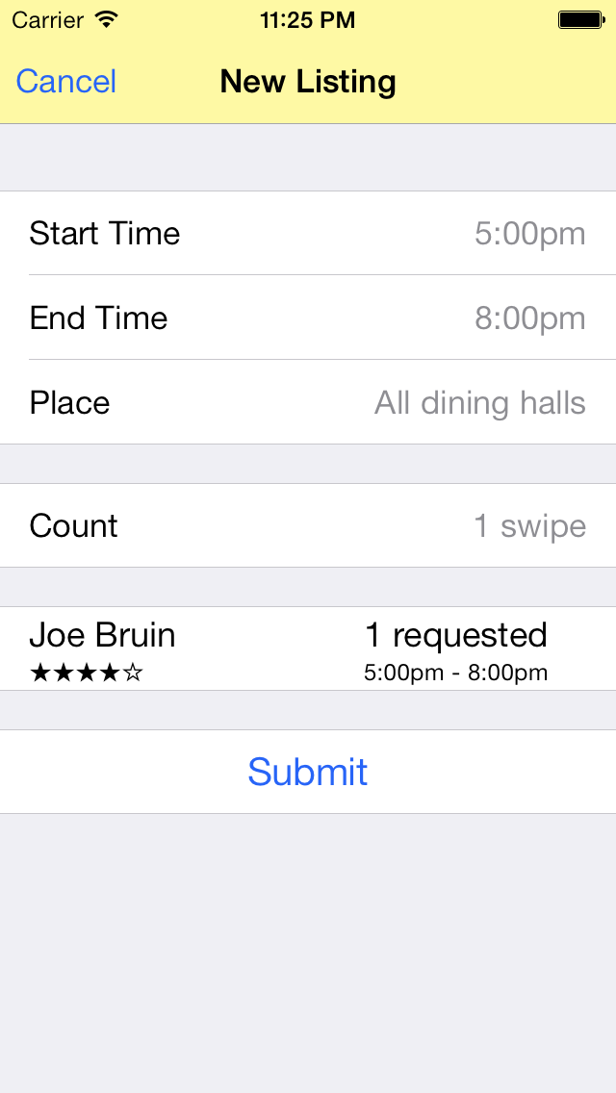
iPhone UI
Notes:
Presenting: Matthew

Slide 16
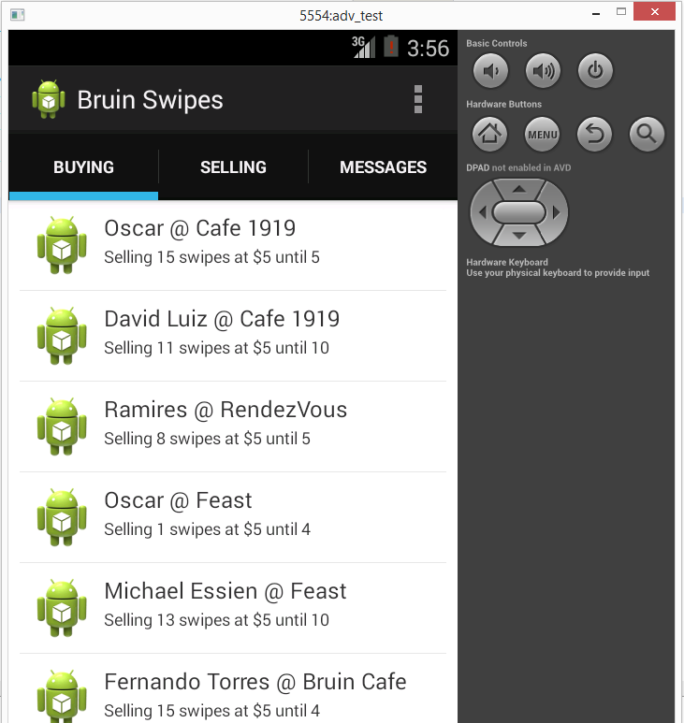
Android UI
A work in progress.
Notes:
Presenting: Yuncun

Slide 17
Demo
Notes:
Presenting: Matthew
(iOS interface demo)

Slide 18
Problems
- Backend support for iOS
Notes:
Presenting: Yuncun
iOS issues
Inline picker views
Android issues
Long setup?
Google issues
Price
iOS support

Slide 19
Audience Help?
Cheaper source for push notifications?
Prefered rating system
★★★★☆ or 5 ✓ 1 ✗
Notes:
Presenting: Matthew

